Slide 1
Technical Deep Dive: Creating Apps for the Intelligent Cloud Module 2 – Micro Services & Service Fabric Deep Dive
Henrique Graça

Slide 2
Agenda
The microservices approach, concepts and benefits
Variants of microservices
Azure Service Fabric
Containers and microservices
Common Scenarios
.NET Core + Linux Servers
Load balancing
DNS & Reverse Lookup in Microservices
Kubernetes (AKS)

Slide 3
The microservices approach, concepts and benefits

Slide 4
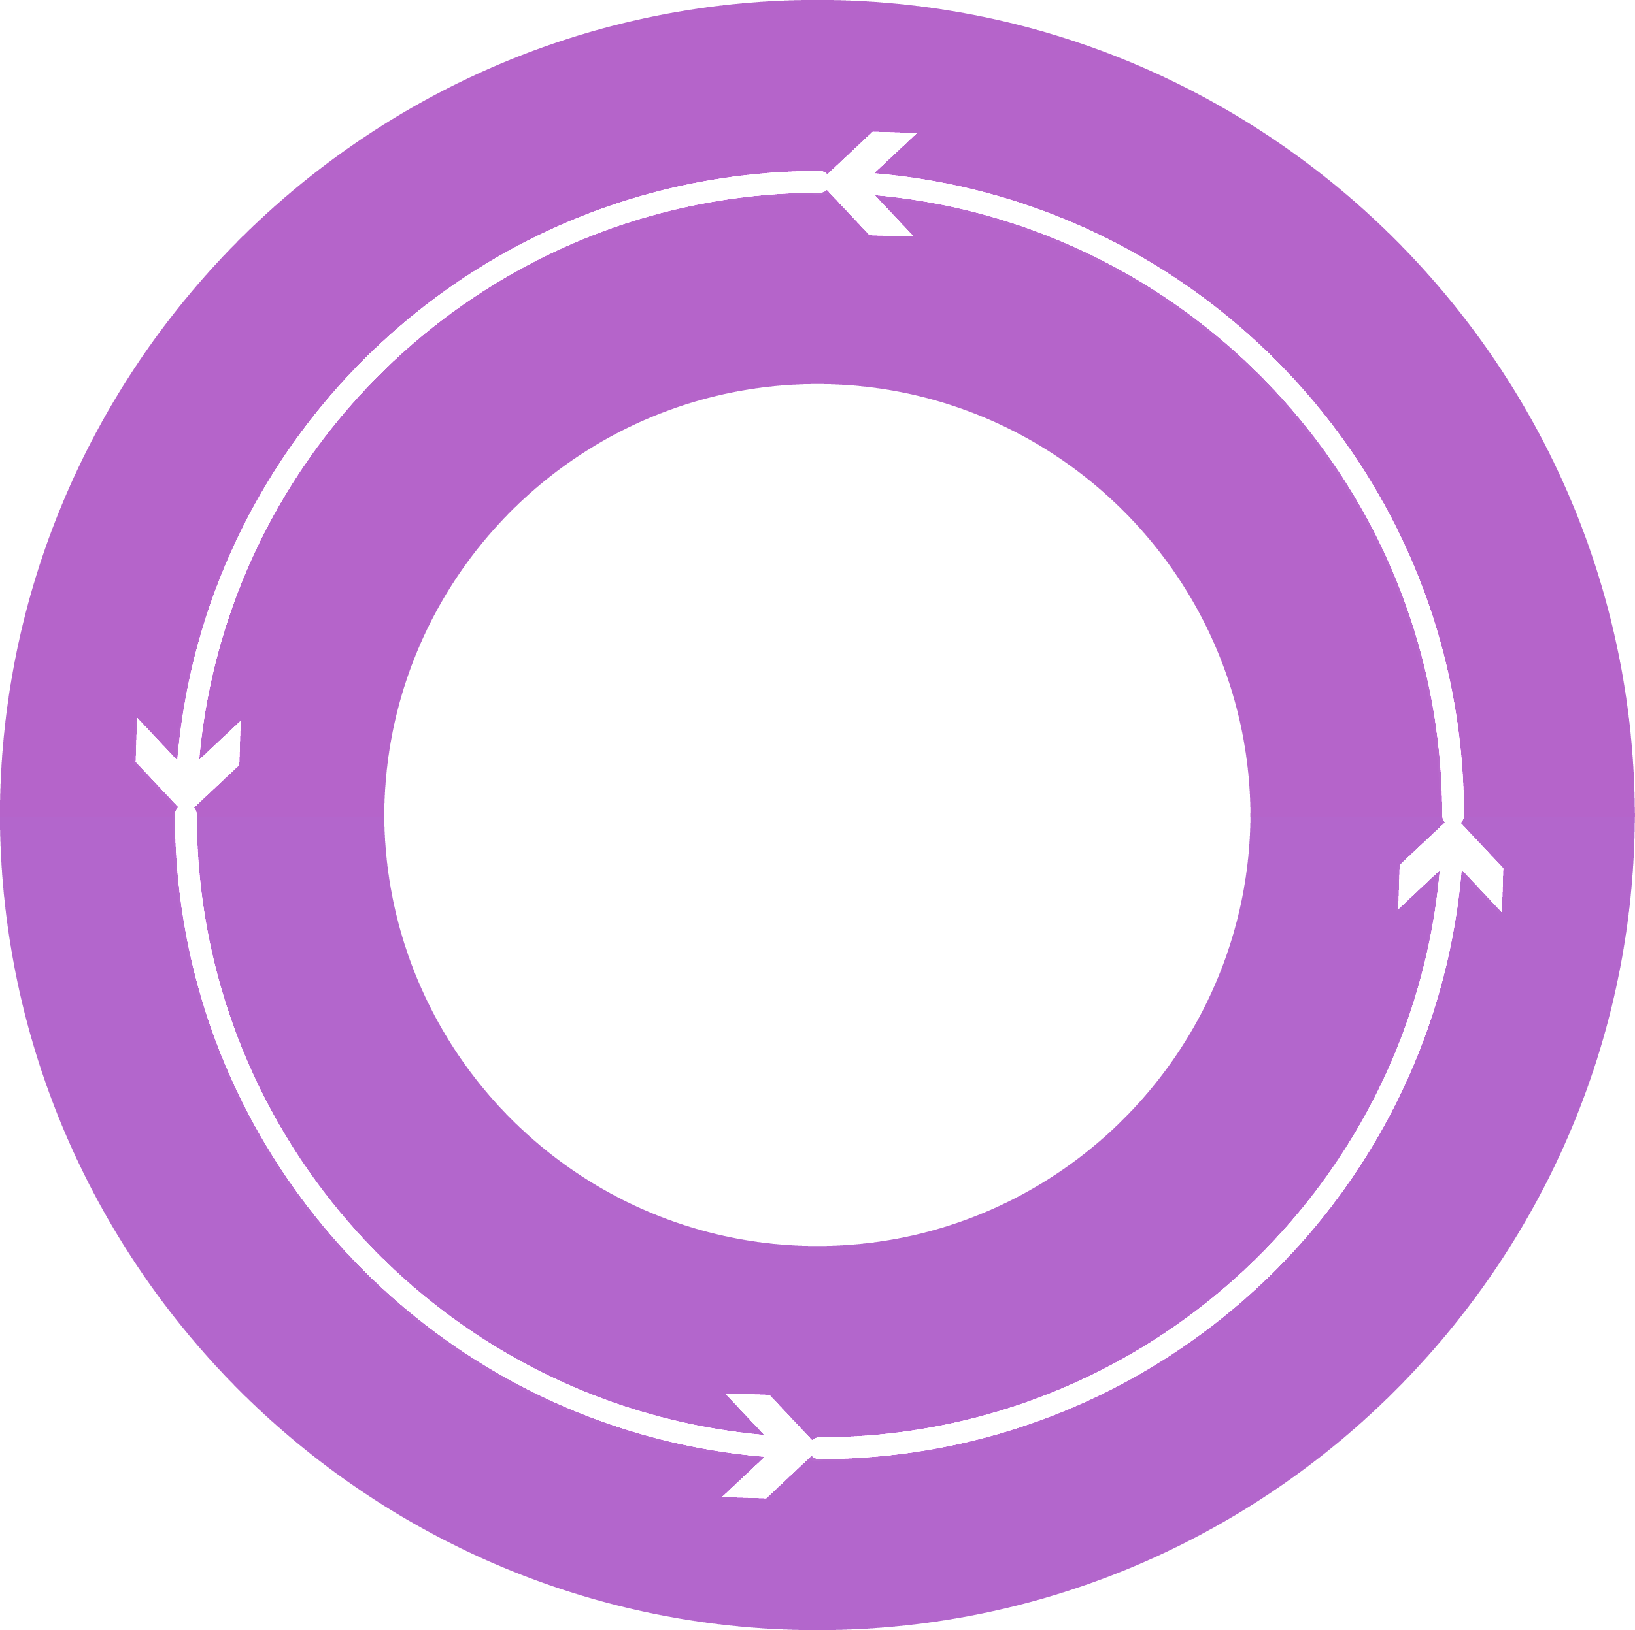



Why a microservices approach?
1
4
Monitor + Learn
Plan
Changing business needs:
Continually evolving applications
Faster delivery of features to respond to customer needs
Build and operate a service at scale
Improved resource utilization/cost reduction
Development
Production
2
3
Release
Develop + Test
Notes:
Speaker Notes:
Purpose: Explain why the microservices approach came into existence and what problems it solves
As software developers, there is nothing new in how we think about factoring an application into component parts. It is the central paradigm of object orientation, software abstractions, and componentization. Today, this factorization tends to take the form of classes and interfaces between shared libraries and technology layers. Typically, a tiered approach is taken with a back-end store, middle-tier business logic, and a front-end user interface (UI). What has changed over the last few years is that we, as developers, are building distributed applications that are for the cloud and driven by the business.+
The changing business needs are:+
A service that's built and operates at scale to reach customers in new geographical regions (for example).
Faster delivery of features and capabilities to be able to respond to customer demands in an agile way.
Improved resource utilization to reduce costs.
+
These business needs are affecting how we build applications.
Read the following overview
https://docs.microsoft.com/en-us/azure/service-fabric/service-fabric-overview-microservices
Gartner Definition of Cloud-Native Applications
This use case includes applications at any scale, which have been written with the strengths and weaknesses of public cloud IaaS in mind. Cloud-native applications assume that resilience must reside in the application and not in the infrastructure (low "compute resilience" weighting), that the application can run well in a variety of underlying infrastructure configurations (low "architecture flexibility" weighting), that the customer's IT organization will attend to security concerns (low "security and compliance" weighting), and that there are only minimal integrations with existing on-premises infrastructure and applications (low "enterprise integration" weighting). Automation, API capabilities and scale-out capabilities are, however, extremely important. Because many such applications have big data aspects, the big data enablement capability also receives a high weighting in this use case

Slide 5


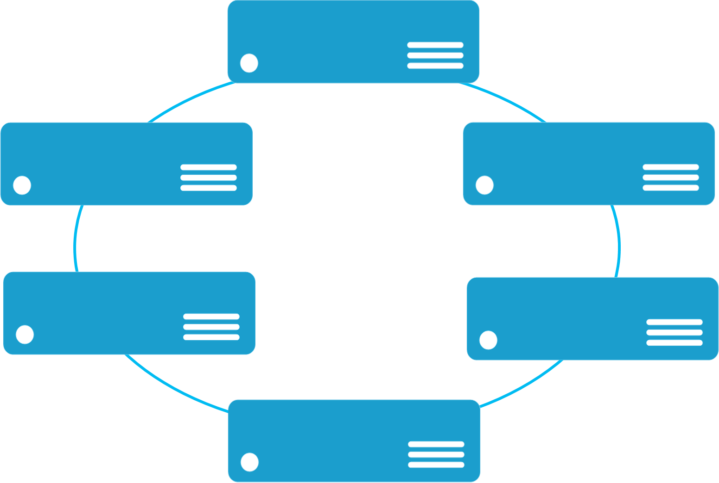


Monolithic application approach
Microservices application approach
Contains domain specific functionality and is normally divided by functional layers:
web, business and data
App 1
App 1
App 2
Separates functionality into
separate smaller services.
Scales out by deploying each service independently creating instances of these services across servers/VMs/containers
Scales by cloning the app on multiple servers/VMs/Containers
Notes:
Speaker Notes:
Purpose: Differentiate the microservices approach with the monolithic approach.
The monolithic approach typically consists of an application that is typically 3-tiered. Even though we have split the single application into 3 tiers, updating or changing any one of the tier is going to affect the entire system. The 3-tiered approach and splitting the application into different components with well defined interfaces only helped in management, but not in seamless business continuity and agility.
For one, handling patching and upgrading involved bringing down the application for a considerable amount of time.
Microservices on the other hand, splits up each component that can be independent into a separate service and allows for independent scaling, load balancing and seamless upgradation.
1) A monolithic app contains domain-specific functionality and is normally divided by functional layers, such as web, business, and data.+
2) You scale a monolithic app by cloning it on multiple servers/virtual machines/containers.+
3) A microservice application separates functionality into separate smaller services.+
4) The microservices approach scales out by deploying each service independently, creating instances of these services across servers/virtual machines/containers.

Slide 6
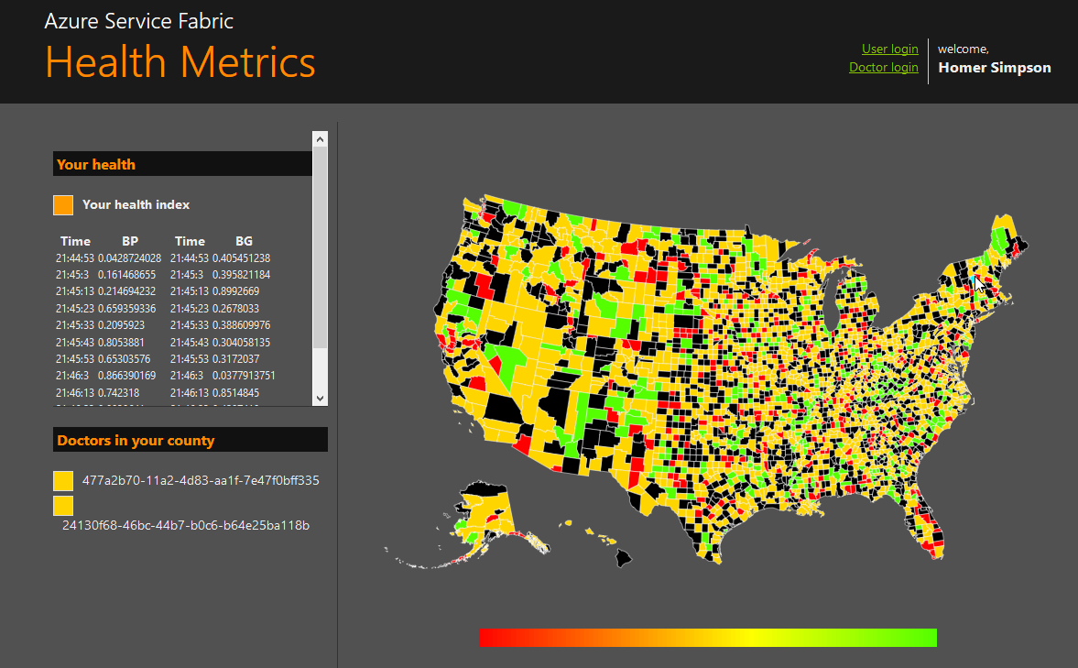
State in Monolithic approach
State in Microservices approach
Single monolithic database
Tiers of specific technologies
Graph of interconnected microservices
State typically scoped to the microservice
Variety of technologies used
stateless presentation services
stateless services
stateful services
stateless services with
separate stores
Notes:
Speaker Notes:
Purpose: Explain how state is handled in Monolithic approach and the different ways of managing state in Microservices approach
State in a monolithic application can only be stored within the application, when there is no scale-out scenario. And in all other cases, the state has to be externalized.
Accessing the state from these external sources adds on to the performance time and latency of the overall application
Microservices approach provides multiple ways of dealing with this.
We have the same default approach of externalizing the state.
We also have stateful microservices wherein the state is stored within the process, and even in scale-out scenarios the state is replicated across all the instances automatically.
The monolithic approach on the left has a single database and tiers of specific technologies.+
The microservices approach on the right has a graph of interconnected microservices where state is typically scoped to the microservice and various technologies are used.
Talk about reliable collections here - https://docs.microsoft.com/en-us/azure/service-fabric/service-fabric-reliable-services-reliable-collections

Slide 7
Microservice architecture benefits
Scale Independently
Different Technology Stacks
Photo Share Service
Thumbnail Service
Photo Share Service node.js
Thumbnail Service .NET
Photo Share Service
Thumbnail Service
Photo Share Service
Thumbnail Service
Photo Share Service
Independent Deployments
Photo Share Service V1
Thumbnail Service V2
Thumbnail Service V1
http://aka.ms/servicefabricdocs and https://aka.ms/microservicesebook
Notes:
Speaker Notes:
Microservice approach is to compose your application of many small services. The services run in containers that are deployed across a cluster of machines. Smaller teams develop a service that focuses on a scenario and independently test, version, deploy, and scale each service so that the entire application can evolve.

Slide 8
Microservices is an Application Design Pattern
Small units of responsibility
Structured interfaces and communication
Potentially different technology choices
Generally horizontally scalable
Notes:
Speaker Notes:
There are different definitions of microservices. If you search the Internet, you'll find many useful resources that provide their own viewpoints and definitions. However, most of the following characteristics of microservices are widely agreed upon:+
Encapsulate a customer or business scenario. What is the problem you are solving?
Developed by a small engineering team.
Written in any programming language and use any framework.
Consist of code and (optionally) state, both of which are independently versioned, deployed, and scaled.
Interact with other microservices over well-defined interfaces and protocols.
Have unique names (URLs) used to resolve their location.
Remain consistent and available in the presence of failures.
+
You can summarize these characteristics into:+
Microservice applications are composed of small, independently versioned, and scalable customer-focused services that communicate with each other over standard protocols with well-defined interfaces.

Slide 9
Microservices platform
Build applications with multiple frameworks, containers and languages
Microservices Platform
Deploy and manage applications to many environments
Notes:
Speaker Notes:
Written in any programming language and use any framework
As developers, we should be free to choose a language or framework that we want, depending on our skills or the needs of the service. In some services, you might value the performance benefits of C++ above all else. In other services, the ease of managed development in C# or Java might be most important. In some cases, you may need to use a specific partner library, data storage technology, or means of exposing the service to clients.+
After you have chosen a technology, you come to the operational or lifecycle management and scaling of the service.+
Allows code and state to be independently versioned, deployed, and scaled
However you choose to write your microservices, the code and optionally the state should independently deploy, upgrade, and scale. This is actually one of the harder problems to solve, because it comes down to your choice of technologies. For scaling, understanding how to partition (or shard) both the code and state is challenging. When the code and state use separate technologies, which is common today, the deployment scripts for your microservice need to be able to cope with scaling them both. This is also about agility and flexibility, so you can upgrade some of the microservices without having to upgrade all of them at once.+

Slide 10
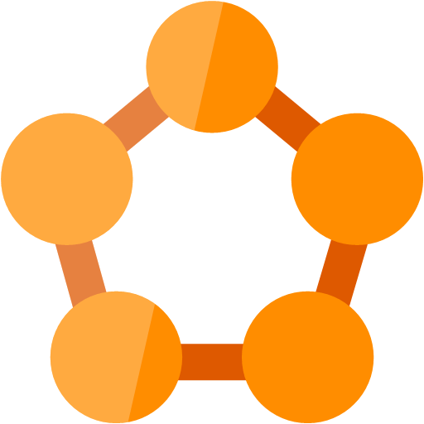



Modernize Applications
Containerize
Modernize
Decompose
Transformed
Traditional application
Hosted as guest executables or containers in Service Fabric
Modernization by adding new microservices
Innovate by decomposing application into microservices
Transformed into microservices or new greenfield application
…You can stop at any stage
Notes:
Speaker Notes:
Modernize your applications by transforming to microservices.
There are five stages to application modernization, and you can start and stop at any of the stages. These are;+
1) Take a traditional monolithic application 2) Lift and Shift - Use containers or guest executables to host existing code in Service Fabric. 3) Modernization - New microservices added alongside existing containerized code. 4) Innovate - Break the monolithic into microservices purely based on need. 5) Transformed into microservices - the transformation of existing monolithic applications or building new greenfield applications.

Slide 11
Benefits enabled by microservices…
Increase agility through componentization
Simplify upgrades through independent versioning
Maximize productivity through heterogeneous technologies
Improve hardware utilization through granular resource balancing
Limit the impact of failures through isolation
Notes:
Talking Points: Explain the slide notes.
Independent Development: Small, independent components can be built by small, independent teams. A group can work on a change to the 'Upload' service without interfering with the 'Transcode' service, or even knowing about it. The amount of time to learn about a component is greatly reduced, and it is easier to develop new features.
Independent Deployment: Each individual component can be deployed independently. This allows new features to be released with greater velocity and less risk. Fixes or features for the 'Streaming' component can be deployed without requiring other components to be deployed.
Independent Scalability: Each component can be scaled independently of each other. During busy periods when new shows are released, the 'Download' component can be scaled up to handle the increased load, without having to scale up every component, which makes elastic scaling more feasible and reduces costs.
Reusability: Components fulfil a small, specific function. This means that they can more easily be adapted for use in other systems, services or products. The 'Transcode' component could be used by other business units, or even turned into a new business, perhaps offering transcoding services for other groups.
At this level of detail, the benefits of a microservice model over a monolithic model seem obvious. So if that's the case - why is this pattern only recently in vogue? Where has it been all my life?

Slide 12
Variants of microservices

Slide 13
Variants of microservices
"Container" based
"Azure Service Fabric Programming Model" based
Notes:
In general we have two variants of microservices supported on Azure. These are „Container based“ microservices and microservices using the „Azure Service Fabric Programming Model“.

Slide 14
"Container" based microservices
Docker Container
Windows based
Linux based
Azure Services:
Azure Container Service
Azure Service Fabric
Notes:
If we talk about container in this context, we talk about Docker container. These are containers created using the Docker tools chain. This is available for Windows and Linux operating systems. Also the resulting containers can run on Linux and Windows operating systems
On Azure we have a few services where docker containers can run as a unit of execution. But today we talk about applications composed of microservices and for this purpose we have two services in Azure where docker container can be used. These are Azure Container Service and Azure Service Fabric.
Azure Container Service makes it simple to create, configure, and manage a cluster of virtual machines that are preconfigured to run containerized applications. You can choose to use Kubernetes, DC/OS-Mesos and Docker Swarm to orchestrate your cluster. In my eyes Azure Container Service is the right choice for you if your experience is more within the Linux based, Open Source software world and you have a lot of experience with these open source orchestrators.
Azure Service Fabric provides Linux and Windows based cluster, has it’s own integrated orchestrator and a programming model that helps developer to build reliable services with strong support for statefull services and so called reliable actors following the actor programming model.
Today we want to focus on Azure Service Fabric

Slide 15
"Azure Service Fabric API" microservices
Services
Executables
Azure Services:
Azure Service Fabric
Notes:
We saw already that you can use containers in Azure Service Fabric service. Additionally Azure Service Fabric has it’s own programming model. With the Service Fabric APIs you can take the full advantage of the platform's features and application frameworks. Using this model you can write stateless and stateful services using the reliable services API or so called “Reliable Actors” following the actors pattern.
Services can also be any compiled executable program written in any language.
It is very important to understand that you can mix these general options to build microservices applications.
Now it is time to have a deeper look to Azure Service Fabric.

Slide 16
However, devs now need to code for…
Service discovery
State management
Service lifecycle management
Health & resource usage reporting
Placement of services
Scaling in/out on demand
Failure resiliency
Notes:
Developers need to take care of additional things now
What's the problem with microservices?
If microservices are so great, what's the big deal? Here are some of the biggest issues I've seen.
Increased complexity for developers
Things can get a lot harder for developers. In the case where a developer wants to work on a journey, or feature which might span many services, that developer has to run them all on their machine, or connect to them. This is often more complex than simply running a single program.
This challenge can be partially mitigated with tooling³, but as the number of services which makes up a system increases, the more challenges developers will face when running the system as a whole.
Increased complexity for operators
For teams who don't develop services, but maintain them, there is an explosion in potential complexity. Instead of perhaps managing a few running services, they are managing dozens, hundreds or thousands of running services. There are more services, more communication paths, and more areas of potential failure.
Increased complexity for devops
Reading the two points above, it may grate that operations and development are treated separately, especially given the popularity of devops as a practice (which I am a big proponent of). Doesn't devops mitigate this?
The challenge is that many organisations still run with separated development and operations teams - and a organisation that does is much more likely to struggle with adoption of microservices.
For organisations which have adopted devops, it's still hard. Being both a developer and an operator is already tough (but critical to build good software), but having to also understand the nuances of container orchestration systems, particularly systems which are evolving at a rapid pace, is very hard. Which brings me onto the next point.
It requires serious expertise
When done by experts, the results can be wonderful. But imagine an organisation where perhaps things are not running smoothly with a single monolithic system. What possible reason would there be that things would be any better by increasing the number of systems, which increases the operational complexity?
Yes, with effective automation, monitoring, orchestration and so on, this is all possible. But the challenge is rarely the technology - the challenge is finding people who can use it effectively. These skillsets are currently in very high demand, and may be difficult to find.
Real world systems often have poorly defined boundaries
In all of the examples we used to describe the benefits of microservices, we spoke about independent components. However in many cases components are simply not independent. On paper, certain domains may look bounded, but as you get into the muddy details, you may find that they are more challenging to model than you anticipated.
This is where things can get extremely complex. If your boundaries are actually not well defined, then what happens is that even though theoretically services can be deployed in isolation, you find that due to the inter-dependencies between services, you have to deploy sets of services as a group.
This then means that you need to manage coherent versions of services which are proven and tested when working together, you don't actually have an independently deployable system, because to deploy a new feature, you need to carefully orchestrate the simultaneous deployment of many services.
The complexities of state are often ignored
In the previous example, I mentioned that a feature deployment may require the simultaneous rollout of many versions of many services in tandem. It is tempting to assume that sensible deployment techniques will mitigate this, for example blue/green deployments (which most service orchestration platforms handle with little effort), or multiple versions of a service being run in parallel, with consuming channels deciding which version to use.
These techniques mitigate a large number of the challenges if the services are stateless. But stateless services are quite frankly, easy to deal with. In fact, if you have stateless services, then I'd be inclined to consider skipping microservices altogether and consider using a serverless model.
In reality, many services require state. An example from our video sharing platform might be the subscription service. A new version of the subscriptions service may store data in the subscriptions database in a different shape. If you are running both services in parallel, you are running the system with two schemas at once. If you do a blue green deployment, and other services depend on data in the new shape, then they must be updated at the same time, and if the subscription service deployment fails and rolls back, they might need to roll back too, with cascading consequences.
Again, it might be tempting to think that with NoSQL databases these issues of schema go away, but they don't. Databases which don't enforce schema do not lead to schemaless systems - they just mean that schema tends to be managed at the application level, rather than the database level. The fundamental challenge of understanding the shape of your data, and how it evolves, cannot be eliminated.
The complexitities of communication are often ignored
As you build a large network of services which depend on each other, the liklihood is that there will be a lot of inter-service communication. This leads to a few challenges. Firstly, there are a lot more points at which things can fail. We must expect that network calls will fail, which means when one service calls another, it should expect to have to retry a number of times at the least. Now when a service has to potentially call many services, we end up in a complicated situation.
Image a user uploads a video in the video sharing service. We might need to run the upload service, pass data to the transcode service, update subscriptions, update recommendations and so on. All of these calls require a degree of orchestration, if things fail we need to retry.
This retry logic can get hard to manage. Trying to do things synchronously often ends up being untenable, there are too many points of failure. In this case, a more reliable solution is to use asynchronous patterns to handle communication. The challenge here is that asynchronous patterns inherently make a system stateful. As mentioned in the previous point, stateful systems and systems with distributed state are very hard to handle.
When a microservice system uses messaging or queues for intra-service communication, you essentially have a large database (the message queue or broker) glueing the services together. Again, although it might not seem like a challenge at first, schema will come back to bite you. A service at version X might write a message with a certain format, services which depend on this message will also need to be updated when the sending service changes the details of the message it sends.
It is possible to have services which can handle messages in many different formats, but this is hard to manage. Now when deploying new versions of services, you will have times where two different versions of a service may be trying to process messages from the same queue, perhaps even messages sent by different versions of a sending service. This can lead to complicated edge cases. To avoid these edge cases, it may be easier to only allow certain versions of messages to exist, meaning that you need to deploy a set of versions of a set of services as a coherent whole, ensuring messages of older versions are drained appropriately first.
This highlights again that the idea of independent deployments may not hold as expected when you get into the details.
Versioning can be hard
To mitigate the challenges mentioned previously, versioning needs to be very carefully managed. Again, there can be a tendency to assume that following a standard such as semver[4] will solve the problem. It doesn't. Semver is a sensible convention to use, but you will still have to track the versions of services and APIs which can work together.
This can get very challenging very quickly, and may get to the point where you don't know which versions of services will actually work properly together.
Managing dependencies in software systems is notoriously hard, whether it is node modules, Java modules, C libraries or whatever. The challenges of conflicts between independent components when consumed by a single entity are very hard to deal with.
These challenges are hard to deal with when the dependencies are static, and can be patched, updated, edited and so on, but if the dependencies are themselves live services, then you may not be able to just update them - you may have to run many versions (with the challenges already described) or bring down the system until it is fixed holistically.
Distributed Transactions
In situations where you need transaction integrity across an operation, microservices can be very painful. Distributed state is hard to deal with, many small units which can fail make orchestrating transactions very hard.
It may be tempting to attempt to avoid the problem by making operations idempotent, offering retry mechanisms and so on, and in many cases this might work. But you may have scenarios where you simply need a transaction to fail or succeed, and never be in an intermediate state. The effort involved in working around this or implementing it in a microservice model may be very high.
Microservices can be monoliths in disguise
Yes, individual services and components may be deployed in isolation, however in most cases you are going to have to be running some kind of orchestration platform, such as Kubernetes. If you are using a managed service, such as Google's GKE⁵ or Amazon's EKS⁶, then a large amount of the complexity of managing the cluster is handled for you.
However, if you are managing the cluster yourself, you are managing a large, complicated, mission critical system. Although the individual services may have all of the benefits described earlier, you need to very carefully manage your cluster. Deployments of this system can be hard, updates can be hard, failover can be hard and so on.

Slide 17
Containers have similar issues….
Containers need to discover and talk to each other
Containers need to manage state
Containers need to be upgraded with zero downtime
Containers need to report health & resource usage
Containers need to be placed appropriately
Containers need to be scaled in/out on demand
Containers need to be resilient to HW and SW faults
Notes:
Talk through the points

Slide 18
Azure Service Fabric

Slide 19
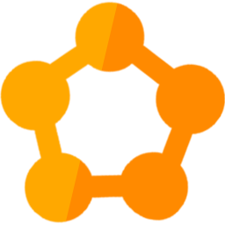
Battle-tested Service Fabric makes it easy
Rolling Upgrades
Availability Guarantees
Scale Out Architecture
Resource Governance
Density
Packaging & Deployment
Policy Enforcement
Granular Versioning
Statefull Workloads
Leader Election
Service Fabric
Notes:
Features which are available in SF out of the box. Refer this link to know more

Slide 20



Azure Service Fabric
Any OS, Any Cloud
Lifecycle
Management
Always On Availability
Programming Models
Health & Monitoring
Dev & Ops Tooling
Auto
scaling
Orchestration
SDK Available
Managed Service
Deployment Packages
Deployment Packages
Coming soon
Coming soon
Dev Box
Azure
On-Premise Data centers
Other Clouds
Azure Stack
Coming soon
Notes:
Service Fabric Supported on Any OS(As of today we support two operating systems one on Linux its Ubuntu and the other one is Windows ) and Any Cloud.
Talk briefly on the Individual Capabilities
Lifecycle Management
Always On Availability
Orchestration
Monitoring, Scaling and DevOps
Its also available everywhere
1. with the devbox available through SDK for Windows and Linux
2. In Azure as Managed Service supporting both Windows and Linux(You can talk about the latest version of the Windows and Linux server its supported)
3 You can also take the package and deploy it in your on premise cluster or any other cloud platform. Currently Windows is supported but pretty soon we going to give support for Linux as well.

Slide 21
Service Fabric supports Hybrid Applications
On Premise or other Clouds
Service Fabric for Windows Server
Active Directory or Certificates
SQL Server
In Azure
Service Fabric service
Azure Active Directory and Certificates
Azure SQL Database
Azure Stack GA with Service Fabric
Service Fabric service
Azure Active Directory and Certificates
Azure SQL Database
Coming Soon!
Notes:
Service fabric offerings allowing you to write hybrid applications once, and deploying it

Slide 22




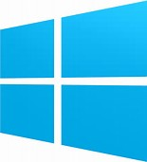

Service Fabric Programming Models & CI/CD
Visual
Studio
&
VSTS
Jenkins
&
Eclipse
ASP.NET Core
Reliable Actors
Diagnostics & Monitoring
AppInsights
OMS
ELK
Reliable Services
Guest Executables
Containers
Lifecycle
Management
Auto
scaling
Lifecycle
Management
Always On Availability
Orchestration
Programming Models
Health & Monitoring
Dev & Ops Tooling
Auto
scaling
Dev Box
Azure
On Premise
Other Clouds
Notes:
Web apps – use ASP.NET Core or OWIN.

Slide 23
Service Fabric Cluster
FD1/UD6
Node
Machines stitched together
Scales to 1000+ machines
Single management endpoint
Layout limits impact of HW failures
FD0/UD0
FD1/UD5
Node
Node
FD0/UD1
FD2/UD4
Node
Node
FD2/UD3
Node
Notes:
SF Cluster: A network-connected set of virtual or physical machines into which your microservices are deployed and managed. Clusters can scale to thousands of machines.
Node: A machine or VM that's part of a cluster is called a node. Each node is assigned a node name (a string).
Nodes are deployed across FD's and UD's which limits the impact of HW failures.

Slide 24
Demo:
Service Fabric Portal

Slide 25
Service Fabric Client Modules
AzureRM.ServiceFabric PowerShell module
Azure Service Fabric CLI module
Automates many E2E scenarios
Creating a secure cluster
Adding or removing nodes from a cluster
Adding or removing NodeTypes from a cluster
Adding new cluster and client certificates to a cluster
Switching the cluster upgrade mode from Automatic to Manual or vice-versa
Updating service fabric settings
Ships as a part of Azure PowerShell and CLI respectively
Both modules are supported in cloud shell
In preview for now, so feedback is appreciated
Notes:
Talk about the new az sf cli module and what all things it can do.
Service Fabric CLI is used to directly connect to the Service Fabric cluster (regardless of where it's hosted) and manage the cluster, applications, and services.
Preview means the commands are in preview not the runtime
Check here to know more: https://docs.microsoft.com/en-us/azure/service-fabric/service-fabric-cli

Slide 26
New-AzureRmServiceFabricCluster
Ships with four parameter sets
Supports majority of ‘create new service fabric cluster’ scenarios
Example with minimum set of parameters - create a secure cluster with a self signed cert, and optionally downloading it locally:
New-AzureRmServiceFabricCluster -ResourceGroupName $RGname -Location $clusterloc -ClusterSize $numNodes -VmPassword $pwd -CertificateSubjectName $subname -CertificatePassword $pwd -CertificateOutputFolder $pfxfolder
Notes:
Code to create a new Sf Cluster

Slide 27
Scaling an Azure cluster in or out
Safest option:
Use the Azure PS to perform this operation
Add nodes
Add-AzureRmServiceFabricNode -ResourceGroupName $RGname -Name $clusterName -NodeType $nodeType -Number $addNumNodes
Remove nodes
Remove-AzureRmServiceFabricNode -ResourceGroupName $RGname -Name $clusterName -NodeType $nodeType -Number $addNumNodes
Notes:
Two ways to scale your cluster – Add Nodes or Add NodeType…

Slide 28
Scaling an Azure cluster in or out
Safest option:
Use the Azure PS to perform this operation
Add a new NodeType
Add-AzureRmServiceFabricNodetype -ResourceGroupName $RGname -Name $clusterName -NodeType $nodeType ……
Remove a new NodeType
Remove-AzureRmServiceFabricNodeType -ResourceGroupName $RGname -Name $clusterName -NodeType $nodeType …..

Slide 29
Service Fabric Cluster Planning
Define what the cluster will be used for
Is this to be used for Test?
Is this a part of the CI/CD pipeline?
Is this for Production use?
Determine the node types and sizes
For each application planned to be deployed – do a sizing exercise
Ports to be opened etc.
Are there any unique compliance or security requirements?
Compliance expectations from infrastructure and applications
Notes:
Discuss on the importance of cluster planning
Customers should consider in what scenario the cluster will be used do not use multipurpose cluster, the node types and also security compliances
Go through this link to know more: https://docs.microsoft.com/en-us/azure/service-fabric/service-fabric-cluster-capacity

Slide 30
Service Fabric Cluster Planning
Where do you want this cluster hosted?
On Azure?
On-Premise, in your data center?
On some other cloud provider?
Choose the # of Fault Domains (FDs)
This determines the headroom needed in case of unplanned failures
Choose the # of Upgrade Domains (UDs)
This determines the headroom needed in case of planned failures
Notes:
Discuss where the cluster is hosted if it's on-premise the customer needs to take care of it
Talk about importance of Fault Domain and Update Domain.
Discuss why we go for a 5 node cluster in Azure for Production Machines running Stateful applications
.
Probability of losing two machines across two different racks is far lesser than losing one and in that case if it’s a stateful application than you lose quorum.

Slide 31
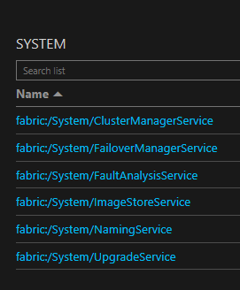
Reliability tier
Sets the number of system services replicas.
Determines how reliable your entire cluster is.
Determines what the primary NodeType size is
The node SKU/Size has no bearing on reliability tier
Reliability Tier | System service replica set size
Bronze | 3
Silver | 5
Gold | 7
Platinum | 9
Notes:
The reliability tier is used to set the number of replicas of the system services that you want to run in this cluster on the primary node type. The more the number of replicas, the more reliable the system services are in your cluster.

Slide 32
Best Practices : Reliability tier
Run production workloads in Azure at Silver or higher
Choose the highest tier you can afford
Adjust the reliability tier on scale out or in
For a one node test cluster, do not specify the reliability tier
Use the same guidance for your stateful services as well
Reliability Tier | System service replica set size | Recommended for Cluster Size of
Bronze | 3 | 3
Silver | 5 | 5 or 6
Gold | 7 | 7 or 8
Platinum | 9 | 9 and up; Cross AZ or Cross Region
Notes:
Talk through the points

Slide 33
Durability tier
Indicates to the system the privileges that your VMs have with the underlying Azure infrastructure
Indicates to the system to favor data safety over operational speed
Will delay all infrastructure operations
Scale out and in operations become easier
Does not apply to the on premise clusters
Durability Tier | Infra privilege time out | Available on VMs SKUs
Bronze | 0 mins | All supported VM SKUs
Silver | 10 mins | All supported VM SKUs
Gold | 120 mins | Full node SKUs like D15_V2, G5
Notes:
This feature is available only in azure
Talk through the points
Bronze your services do not get time to gracefully shutdown properly. As and when update comes it reboots the vm and just goes away. Try out bronze only if your application is a stateless service or you are trying out your state full services and you are not taking care of your all the lifecycle events

Slide 34
Best Practices : Durability tier
Keep your cluster and applications healthy at all times
Respond to all Service replica lifecycle events timely
Adopt safer ways to make a VM SKU change (Scale up/down)
Set expectation :The cluster level and infra operations will slow down
Durability Tier | Infra privilege time out | Available on VMs SKUs
Bronze | 0 mins | All supported VM SKUs
Silver | 10 mins | All supported VM SKUs
Gold | 120 mins | Full node SKUs like D15_V2, G5
Read this carefully : https://docs.microsoft.com/en-us/azure/service-fabric/service-fabric-cluster-capacity
Notes:
If customer is adopting is going with the Durability tier of Silver and Gold they have to be very careful about what is the health of the cluster and application. So keep it healthy all the time.
Respond to all the lifecycle events which the failover manager sends to you.
Talk through the other points

Slide 35
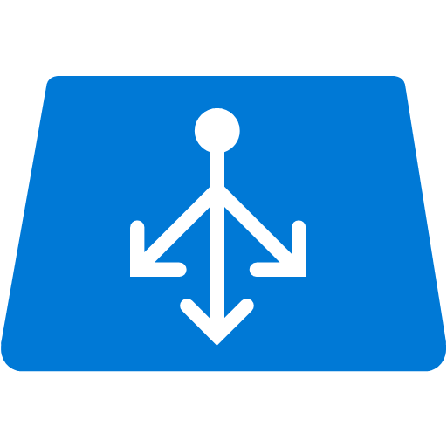


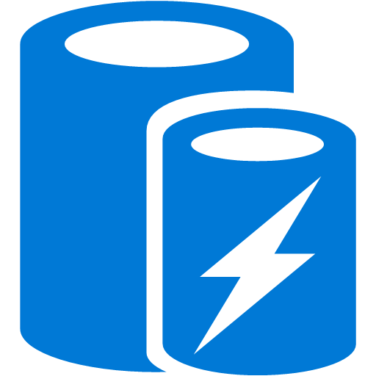


Traditional Service Pattern
Scale: Partition storage
Reliability: Use queues
Latency: Use caches
State consistency: Manage transactions
Load Balancer
Front End
(Stateless
Web)
Stateless
Middle-tier
Compute
Cache
Many moving parts managed differently
Queues Storage
Notes:
Describe the Traditional Application design and focus on the many moving parts which needs to be managed separately

Slide 36

An Alternative Approach: Stateful services
Latency: App state is in the compute tier
Scale: First class partition support
Reliability: Inbuilt in platform
State consistency: Built in transactions
Load Balancer
Front End
(Stateless
Web)
Stateful
Middle-tier
Compute
Simplify design, reduce complexity & errors
data stores used for analytics and disaster recovery
Notes:
How the design can be changed using Service Fabric Stateless and stateful services

Slide 37

Programming models - Windows
Your service
Full .NET Framework
Your service
Any language
ASP.NET Core
Reliable Actors
Reliable Services
Guest Executables
Containers
Notes:
Talk in brief about the different programming models on Windows

Slide 38

Programming models – Linux (preview)
Your service
Java, .NET Core
Your service
Any language
ASP.NET Core
Reliable Actors
(stateful)
Reliable Services (stateless only)
Guest Executables
Containers
Notes:
Talk in brief about the different programming models on Linux

Slide 39
Programming model categories
Guest executables and guest containers
Deploy and manage arbitrary services written in any framework
Service Fabric was there before orchestration was cool
Stateless Services
State persisted to external storage, such as Azure DBs
Existing web and worker role applications
Statefull Services
Reliability of state through replication and local persistence
Lowers latency & reduces complexity in traditional three tier architectures
Notes:
With that background, let talk about what and how you can build applications with Service Fabric
First stateless applications are no different from the web and worker roles that you build today, in that the state is retained in an externalized store such as SQL Azure or Azure storage. This is a fine approach for certain application designs and of course you still need to handle scaling out each tier. Service Fabric brings benefits to the stateless approach with its microservices architecture by enabling fast deployment time (applications are now deployed in seconds) as well as much, much higher density. You can package 1000s of microservices on a VM, where are with Cloud Service today you are forced to have only one service per VM, underutilizing the resources
Stateless services are where you let Service Fabric take care of the application state through replication and local persistence. This is really the democratization of high availability. Everyone, not just databases and high ends stores, can now have HA in your applications through simple programming models with full data consistency. Think about this. Your apps do not need to do lots of data manipulation to write data to another store.
Stateful services are recognition that there are limitation with just a pure stateless service design to address two issues. Reduces latency of your applications and makes it more responsive to users, since data is locally stored. Reduces complexity of you application since you no longer need to have additional caches (which only deal with read latency) and additional queues in order to make your services reliable. You literally remove these extra services from your design, making the overall service simple and have a SINGLE approach to management.
Finally although Service Fabric provides a runtime for you to build applications, this does not prevent you from using other runtime in you applications. So you may have a service that has a node.js front end that communicate with backend stateless and stateful services. Or you may deploy application that run in Java VM or simply deploy some EXE that you have that need to be used by your service. Service Fabric will makes these other runtime reliable, if needed, but ensuring that the specified number of instances is always running. You will get the full benefits of the deep resource balancing of the Service Fabric microservices built with the Service Fabric runtime and ALM capabilities; you can reuse existing code and have the benefit of a SINGLE approach to management. Not bad!

Slide 40
Reliable Actors Framework
Independent unit of state and compute (large number in parallel)
Prescriptive communication model based on async messaging
Automatic state management and turn based concurrency
Notes:
The actor API allows you to build objects with virtual actor programming model. The actors are just like objects, you write your services in a natural object-oriented way. It is suitable for applications with multiple independent units of state and compute. The framework provides automatic state management and simple turn based concurrency model that eliminates the needs to write synchronization code. Let’s go ahead and build a reliable actor using the APIs.

Slide 41
Demo:
Azure Service Fabric Deployment and Explorer

Slide 42
Management & Orchestration
Notes:
Now let us switch gears again and look at the mgmt. and orchestration capabilities of the platform.
Let us start with some conceptual slides*

Slide 43
Service Fabric - Deployment
App1
App2
App Type Packages
Service Fabric Cluster VMs
Notes:
Talk through the Deployment model in Service Fabric where Apps are broken down into Microservices and deployed independently

Slide 44
Handling machine failures
#FAIL
App1
App2
App Type Packages
Service Fabric Cluster VMs
Notes:
Talk through the Fail Over Management model in Service Fabric where whenever node crashes the Service Fabric Runtime routes traffic to the secondary and brings up the services which were running in the node which failed

Slide 45
Orchestration basics - Constraints
Green Nodes
Purple Nodes
App1
App2
App Type Packages
Service Fabric Cluster VMs

Slide 46
Capacity
App1
App2
App Type Packages
Service Fabric Cluster VMs

Slide 47
Resource Balancing
App1
App2
App Type Packages
Service Fabric Cluster VMs

Slide 48
Scaleout services
App1
App2
App Type Packages
Service Fabric Cluster VMs

Slide 49
Scaleout cluster
App1
App2
App Type Packages
Service Fabric Cluster VMs

Slide 50
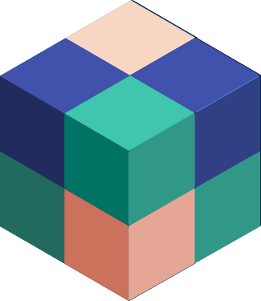
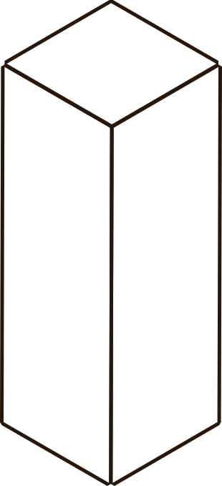



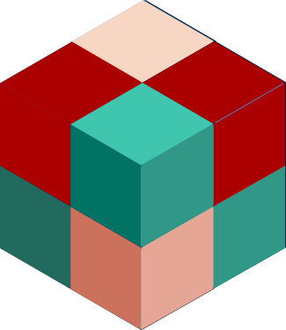


Zero Downtime Upgrades
App v1
FD1/UD5
FD0/UD4
FD1/UD3
App v2
FD0/UD2
FD3/UD2
One UD at a time
Change only modified service
Automatic rollback
Notes:
Zero downtime upgrades.
I have made a code change to app2 /Service package Blue is now Red.*
The upgrade can be kicked off using the PS, or using the APIs that service fabric provides
The upgrades progress one UD at a time, the UD sequence is chosen by Service Fabric.*
Health checks are performed at the beginning of the upgrade and at the end of each UD. If the health policies are not met the upgrade is either rolled back automatically or is paused, so that the developer can debug the issue.
The developer can then can then either restart the upgrade and/or tell the system to proceed forward or rollback.*
At no point is the service availability lost.*
The health policies are defined at a cluster level to act as a global policy for all applications and Nodes in the cluster. Each application can override its health policy at the time of upgrade.
Let me now show you this in action. *

Slide 51
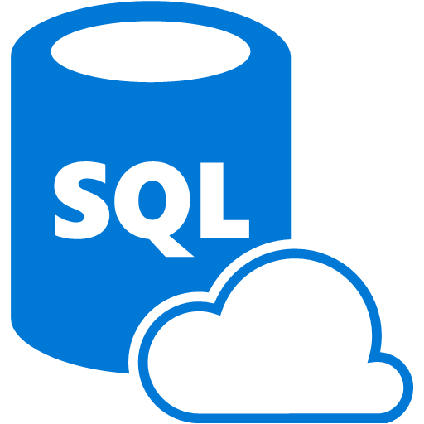
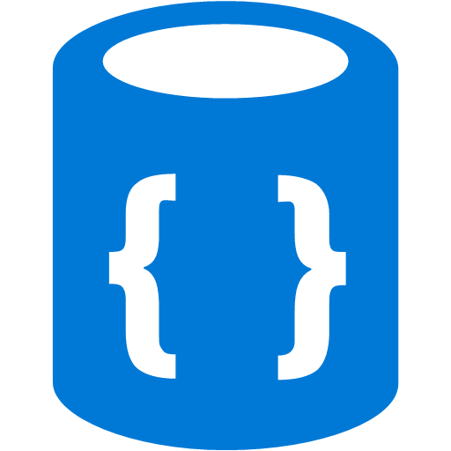


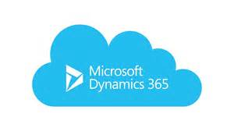

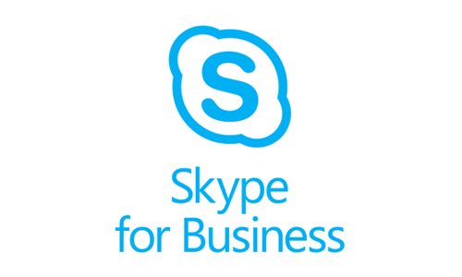

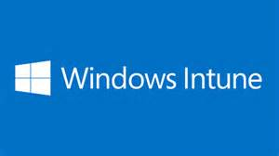
Service Fabric is Microsoft’s orchestrator
Used by massive-scale services with years of optimizations and performance tuning
30% of machine cores in Azure compute runs Service Fabric
SQL Database
2.0 million DBs
Document DB
Billions transactions/day
IoT Hub
millions of messages
Event Hubs
20bn events/day
Skype
Cortana
Intune
Dynamics
Power BI
Notes:
Talk about how service Fabric is used to power some of the internal services

Slide 52
Manage you Cluster Version
Ability to select a supported Fabric version
Set the upgrade mode to – Automatic or Manual
Select the specific fabric version Via APIs or Portal
You can switch between Automatic and Manual
You have 60 days to adopt the new version
A warning is generated 14 days prior to your cluster going out of support
New versions are announced on the team blog
For more details visit this Manage your cluster version page
Notes:
You can set your cluster to receive automatic fabric upgrades, when Microsoft releases a new version or choose to select a supported fabric version you want your cluster to be on.
You do this by setting the "upgradeMode" cluster configuration on the portal or using Resource Manager at the time of creation or later on a live cluster
Talk about the supported version and version expiry - 14 days prior to expiry, the warning comes into play.
How to the customers know that a new version is available
Portal
API – available versions is a part of the cluster resource (REST call).
Email

Slide 53
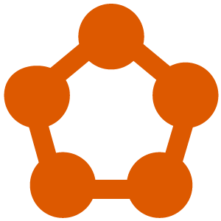

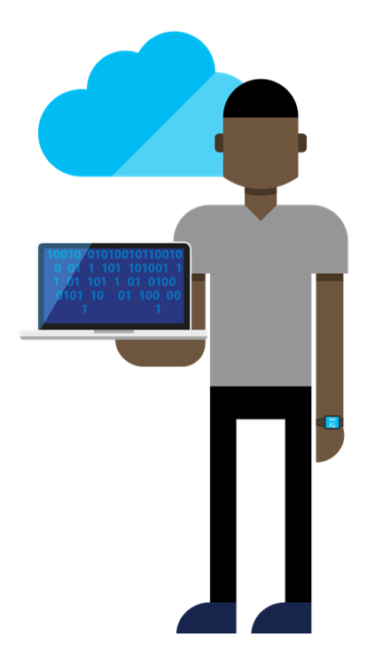


Cluster Fabric Upgrade
Source Control
Build
PPL
Inner Dev Loop
Factors to consider when choosing the upgrade mode
Availability of your service
Need for predictability of performance
Freedom of choice to select the velocity
Support considerations
Recommendation of upgrade mode for – for dev, test, PPL, prod
Test
PROD
DEV
OPS
OPS

Slide 54
Business Continuity Planning
Keep a written, updated, Business Continuity
Define what your RPO and RTO are
RPO - The Recovery Point Objective (RPO) determines the amount of data you can afford to lose in a disaster
RTO - The Recovery Time Objective (RTO) is the maximum tolerable length of time that your service can be down after a disaster occurs
Backup your application state to meet your RPO
Set up clusters across Availability Zones or Even Regions.
Notes:
Talk about why should customers plan for BCP, RPO and RTO
What are the options

Slide 55
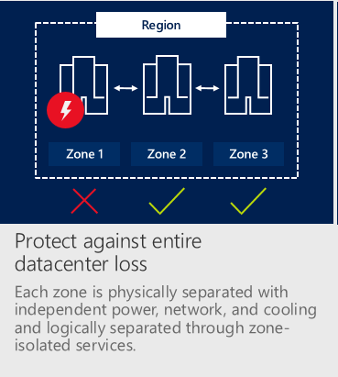
What is an “Availability Zones” (AZ)
Availability Zones (AZ) are physically separated locations within an Azure region
3 zones in each AZ-enabled region
Each zone has independent power, network, and cooling.
Each AZ has 1 to infinite # of DCs. No DC shared by two zones.
VM to VM network latency:
Intra-AZ < 1ms, inter-AZ < 2ms
Notes:
Talk about Availability Zone in Azure

Slide 56
Cluster across three Availability Zones.
Traffic Manager
Single VNET
Three zonal VMSS
Three load balancers
One traffic manager
VMSS #1
VMSS #2
VMSS #3
Subnet #1
Subnet #2
Subnet #3
Availability Zone #1
Availability Zone #2
Availability Zone #3
Single VNET
Service Fabric Cluster
Notes:
One sf cluster deployed within a single VNET. The VM's come from three different scale sets each defined in different zones. You can also use a VIP instead of a traffic manager

Slide 57
Cross Availability Zones Service Fabric cluster
Use a cross AZ cluster when
Want to survive an azure zone going down
RPO and RTO = 0
Slightly higher write latency than a cluster in a single AZ
Back up your application State irrespective
To be used for regional failures and OOPS recovery
Minimum Cluster size
Has to be across 3 or more AZs
Primary node type - 9 VMs minimum
Notes:
Talk through the points

Slide 58
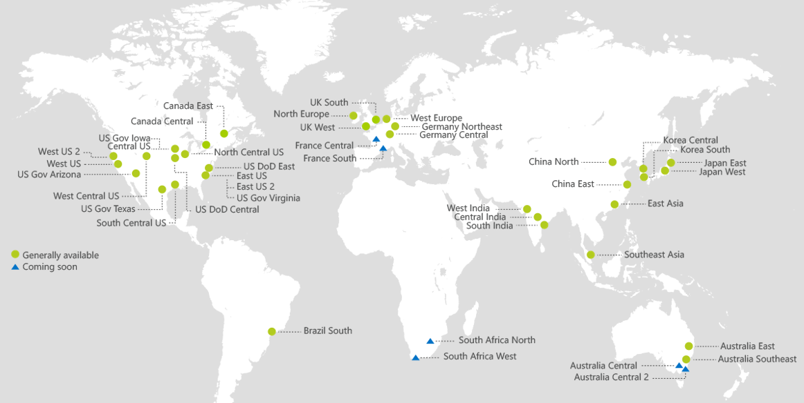
36 Azure Regions
Notes:
The presenter should check the current number of Azure Region at the time of delivering the presentation

Slide 59
Cross regional Service Fabric cluster
Has to span at least 3 regions.
Use it when you want
to survive an azure region going down
RPO and RTO = 0
higher write latency than across AZ is acceptable
Back up your application State
To be used for OOPS recovery
Minimum Cluster size
Has to be across 3 or more Regions
Primary node type – 9 VMs minimum
Notes:
Talk about the points focus on the write latency

Slide 60
Demo:
Cross regional Service Fabric Cluster

Slide 61
Disasters and suggested mitigations
Types of Disasters | RPO and RTO = 0, Write latency acceptable | RPO and RTO > 0
Regional Outage | Cross-regional SF cluster | Stand up a new cluster, restore from backup
Data Center Outage | Cross AZ (3+) SF cluster | Stand up a new cluster, restore from backup
Cluster down | (Very low probability for cross-regional clusters) Stand up a new cluster, restore from backup | Stand up a new cluster, restore from backup
Machine / Node down | Deploy across 5+ FDs, 5+ UDs, Design for write quorum losses | Deploy across 5+ FDs, 5+ UDs, Design for write quorum losses
Other sources of data loss or “oops” | Restore from backup | Restore from backup

Slide 62
Best practices: Cluster Security in Azure
Always use a secure cluster
Cluster node to node security – use Certificates
Client access (Admin and Read only) – use AAD
Use automated deployments
Use scripts to generate, deploy and rollover secrets
Keep the secrets in KV, use AD for all other client access
No human should have access to them without authentication.
Additionally consider the following:
Create DMZs using Network Security Groups (NSGs)
Use Jump servers to RDP into cluster VMs or to manage your cluster
Notes:
Talk through the points

Slide 63
Best practices: Cluster Security in Windows Server (Standalone)
Always use a secure cluster: use AD
Cluster security: Group Managed Service Accounts (gMSA)
Client access (Admin and Read-only): use AD
Use automated deployments
Use scripts to generate, deploy, and rollover secrets
No human should have access to them without authentication
Additionally consider the following:
Create DMZs using Network Security Groups (NSGs) in your load balancer
Use Jump servers to RDP into cluster VMs or to manage the cluster

Slide 64
Monitoring and Diagnostics
Service Fabric out-of-the-box monitoring
Operational events (high level cluster and node events)
Health reports and load balancing decisions made by the system
Data and messaging events
Reliable Services events
Reliable Actors events
System logs (used by us to provide support for your cluster)
Best practices
Always enable diagnostics
Generate custom traces in your applications and services
Set up automated monitoring alerts
Watchdog Service (github.com/Azure-Samples/service-fabric-watchdog-service)
Read more on monitoring and diagnostics in this document
Notes:
Talk through the points Refer this link to learn more https://docs.microsoft.com/en-us/azure/service-fabric/service-fabric-diagnostics-overview

Slide 65
Scenarios to monitor and why
Cluster and Node state
Detect and diagnose hardware and infrastructure issues
Application and Service state
Upgrade status, number of services and replicas
Resource Usage
Do all the nodes need to be up? What is the average CPU usage?
Performance Tracking
Is the cluster healthy? Are all the nodes up?
Detect software and app issues, reduce service downtime
Understand resource consumption and drive better business decisions
Is there any unexpected latency? Are the services responsive?
Optimize application, service, and infrastructure performance
Custom Application Metrics
Is your app being used in the way that you expected? Is solution effective?
Generate business insights and improvements
Notes:
Tal through the points

Slide 66
Containers and microservices

Slide 67
Customer’s pain points
Delivering same functionality to multiple deployment environments
Ensuring consistency and avoiding dependency hell
Unable to migrate and scale apps while maintaining compatibility
Notes:
Problem statement: Lets say you're going to test your app using Python 2.7 in development, and then it's going to run on Python 3 in production and something weird will happen.
Or you'll rely on the behavior of a certain version of an SSL library and another one will be installed. You'll run your tests on Debian and production is on Red Hat and all sorts of weird things happen.
And it's not just different software that can make a difference, The network topology might be different, or the security policies and storage might be different but the software has to run on it.
Customers need a way of bundling an entire runtime environment:
an application
plus all its dependencies, libraries
configuration files
…
needed to run it so that differences in OS distributions and underlying infrastructure are abstracted away.
This way developers can spend more time writing their apps than worry about underlying infrastructure and migration.
Containers are supposed to be the solution to this.

Slide 68
What is a container
Processes
Maximum speed and density
PROCESS
PROCESS
PROCESS
Traditional virtual machines = hardware virtualization
Application
VM
VM
VM
Kernel
OS
Docker Containers
Speed and density
Hardware
CONTAINER
CONTAINER
CONTAINER
Containers = Operating system virtualization
Kernel
OS
CONTAINER
CONTAINER
PROCESS
PROCESS
Hyper-V Containers
Isolation plus performance
Applications
Kernel
CONTAINER
CONTAINER
CONTAINER
Hardware
Kernel
Kernel
Kernel
Hyper-V
Notes:
Typically you run one app or service per container.
The container is an isolation boundary for a service. Within the container you get a file system, a network interface. For the service running within a container it feels like it is the only app running on the system. It can have its own set of dependencies.
Having this kind of encapsulation gives us the option to have multiple containers running on one VM/PC.
Let's have a look, how this isolation level compares to other technologies

Slide 69
Density & Isolation levels
More isolated More efficient
PC
VM
Container
Process
Hardware | Not shared | Shared | Shared | Shared
Kernel | Not shared | Not shared | Shared* | Shared
System Resources (ex: File System) | Not shared | Not shared | Not shared | Shared
* Windows Hyper-V containers do not share a kernel
Notes:
Containers Continue:
We have a correlation between isolation and efficiency.
The base thought here is that the more components are shared the more efficient are components used.
If we use PCs we have nothing shared. Running a service just on this PC would be not very efficient but we would have a very isolated environment
For VMs at least the hardware is shared, so this is a step forward in getting more efficient.
Downside with processes is that they are not well isolated from the rest of the environment and can quickly result in noisy neighbor situations, potentially compromising the entire virtual machine if the code was not written well.
The right compromise thinking about isolation and efficiency are containers. But they solve also further pains.

Slide 70
Density & Isolation
PC/VM
Container: Svc-A:v1
Container: Svc-B:v3
Container: Svc-A:v2
Svc-A v1
Svc-B v3
Svc-A v2
Lib-L v2
Lib-L v3
Lib-L v3
Lib-M v2
Runtime v5
Runtime v7
Runtime v6
Parent Image
Parent Image
Parent Image
Notes:
Let‘s have a more detailed view how container can help us to use different libraries and runtimes
A development is normally started by creating an image. The first step is selecting and adding a base image sometimes also called a parent image. Then additional libraries or runtimes are added, then your service is added. Then the image is used to be run as a container. So now the service runs within a container. So you can of course use the same image to run another instance of this image. Each time the image is used you get the same running, isolated service. In real live you will add the image to a Docker image Registry.
→
2. Because of this isolation I can also have another image using other frameworks, libraries, programming languages for a second container. This might be completely different.
→
3. It is of course also possible to have a second version of that image with updated libraries and runtime.
→
4. They can run side by side on the same PC or VM
This means of course also that these containers start very fast and give us the possibility to get a higher density on the target PC or VM.

Slide 71
“Docker Run App-A:v1”
Operating System
(Linux/Windows)
App-A:v1
Docker Image Repository
Docker Client “docker run App-A:V1”
Docker Daemon
App-A:v1
Local Repository (Ports 2375 & 2376)
App-B:v3
App-A:v2
App-A:v1
Notes:
We have three large components to understand:
We have the docker client, which is command line interface type of application, which can be used to execute commands, like “docker run”
→
“docker run” connects to the docker daemon. This typically runs on a virtual machine. This machine is called the docker host
The docker client can either run in the same machine or externally to the docker host.
In this example “docker run App-A:V1” is called. So the docker daemon has to look for the image “App-A:V1”. In docker we have a local cache sometimes called a local repository or the local registry. Docker images are cached there. So the docker daemon first looks at the local cache.
→
If the docker image has never been used on this system, docker will look in the public repository and download the image to the local cache. There are different docker registries. For example docker hub is a well known public docker registry. This is accessible by everyone. But there are also “private” docker registries like Azure Docker Registry.
So if the docker daemon finds the image it will download the image.
→
Now the image is available and can be launched as a container.

Slide 72
Why containers?
Mitigate “noisy neighbors”
Reduce “works on my machine” vs. in production
Lift and shift existing applications (ex: IIS)
Lift and shift of existing container images
Portability, agility, avoidance of lock-in
Notes:
If you run two processes on a system you may have „Noisy neighbors“ using all resources. With containers you have a way around this as you ca use resource constraints. So in this case you say container 1 is not allowed to use more than 50 % of the CPU.
Often developers have the situation that it works on their dev machines but not on the production machine . Or it works not the same way as a different library is deployed in production environment. With containers you ship the image and these situation are reduced
There are a lot of applications running occupying complete VMs. So you can use containers to move these to the cloud, each one with it’s own set of runtime environment and libraries They can run side by side and this will result in a higher density.
So if your customer has already running containers somewhere, you can use these images and run them on azure.
So this is the advantage of portability, but will also get agility and avoid lock-in

Slide 73
How to orchestrate containers?
Containers need to discover and talk to each other
Containers need to be resilient to hardware and software faults
Containers need to be “placed” appropriately
Containers need to be scaled in/out on demand
Containers need to have rolling upgrades with zero downtime
Service Fabric provides all this out-of-the-box. It is highly optimized and is data-aware….
Notes:
As soon as these services run independently from each other they can be moved around in a cluster and of course the service has to be found by his clients in order to be used.
So what happens in the case of software or hardware faults. The container needs to be started again within the cluster
There are situations where different services need to be placed together on a machine or vice versa. This also needs to be configurable. An example is if some machines in the cluster should not have connection to the internet but other must have. So you will have to place your backend and frontend appropriately.
Scale in/out if requested by demand
And of course rolling updates, so that zero downtime is really possible.
→
All this is solved using Azure Service Fabric

Slide 74
Containers are NOT microservices
Well, you can still put a large monolithic application inside a container….
Microservices are an application design pattern:
Small units of responsibility
Structured interfaces and communication
Potentially different technology choices
Generally horizontally scalable
Notes:
Microservices and container are not the same.
The biggest example I can put on this is you can put a large monolithic application inside a container.
Microservices are an application design pattern:
You break your application in tiny individual parts, give them all different duties, define there communication, write them in different languages and scale them independently.

Slide 75
Demo:
Containers and Microservices

Slide 76
Common Scenarios

Slide 77


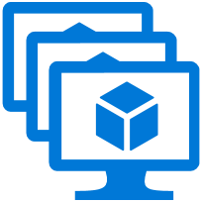
Load Balancer
Service Fabric cluster
A Cluster supports 1,000s of nodes is self repairing, and scales-in and out
Load Balancer
VM Scale set
VM Scale set
VM Scale set
Notes:
Let's talk about communication from external clients. A Service Fabric Cluster in Azure consists of a set VM Scale sets. Therefore if we think about load balancing and external traffic, it is nothing special. We have an Azure Load Balancer in front of our nodes running our services

Slide 78
Load balancing
Azure Load Balancer will forward traffic to a random node that has the port open
Azure Load balancer knows only about ports on nodes
Azure load balancer uses probes to determine whether a node is responding
Don't forget to configure the load balancer for external traffic
Notes:
There is nothing special but there are a few points we need to know.
As Azure Load balancer does not know about services within nodes it can only forward incoming calls to nodes which has the requested port open. Azure Load Balancer will forward traffic to nodes which has the port open. So, don't forget to configure rules for ports you want to have traffic.

Slide 79
Service communication
Microservices in Service Fabric run on a subset of nodes in the cluster
Services may move from one node to another over time
Naming Service can be used for discovery
DNS service
Reverse proxy service
Notes:
Services need to communicate with each other. For this task one service needs to know how to contact another service. As services may move form node to node, service discovery functionality is needed.
Service Fabric provides a discovery and resolution service called the Naming Service. The Naming Service maintains a table that maps named service instances to the endpoint addresses they listen on. All named service instances in Service Fabric have unique names represented as URIs. You can query the naming service by API or by REST.
For stateless services we have also a DNS service which can be enabled. This is very useful for containerized services
Last but not least we have also Reverse proxy service, which can be enabled. Using this service you can use a specialized URI to talk to dedicated services.

Slide 80
DNS Service
DNS Service is optional and can be enabled
Especially useful for containerized services with existing URL name
DNS name can be set using applicationManifest.xml or PowerShell
Can be used for stateless services
Notes:
The DNS service can be enabled for the cluster and it is especially useful for containerized services as they may have a unique URL name. You have to set the DNS name by either using applicationManifest.xml file or by PowerShell. There is one thing to note. The DNS service can only be used by stateless services,

Slide 81
Setting DNS name
ApplicationManifest.xml:
<Service Name="Stateless1" ServiceDnsName="service1.application1">
<StatelessService ServiceTypeName="Stateless1Type" InstanceCount="[Stateless1_InstanceCount]"> <SingletonPartition /> </StatelessService> </Service>
PowerShell:
New-ServiceFabricService ` -Stateless ` -PartitionSchemeSingleton ` -ApplicationName `fabric:/application1 ` -ServiceName fabric:/application1/service1 ` -ServiceTypeName Service1Type ` -InstanceCount 1 ` -ServiceDnsName service1.application1
Notes:
These are the two ways to define a DNS name by using PowerShell or ApplicationManifest.xml

Slide 82
Using DNS names
DNS names can then be used while calling a service
Uri uri = new Uri("http://service1.application1:8080/api/values"); HttpClient client = new HttpClient(); var response = await client.GetAsync(uri); result = await response.Content.ReadAsStringAsync();
Notes:
After the DNS name is defined you can use HTTP endpoints. The DNS service will resolve the address.

Slide 83
Reverse proxy
Can be enabled and configured by node type
Reverse Proxy runs on every node
Can be used for HTTP/HTTPS endpoints
Reverse proxy URI can be used to access service
Especially useful for stateful services
Notes:
Reverse proxy built into Azure Service Fabric helps microservices running in a Service Fabric cluster discover and communicate with other services that have http endpoints.
Reverse proxy is a service that runs on every node and handles endpoint resolution, automatic retry, and other connection failures on behalf of client services.
Using a reverse proxy allows the client service to use any client-side HTTP communication libraries and does not require special resolution and retry logic in the service.
The reverse proxy uses a specific uniform resource identifier (URI) format to identify the service partition to which the incoming request should be forwarded.
This is especially usefull for statefull services

Slide 84
Reverse proxy URI
Example external:
https://mycluster.eastus.cloudapp.azure.com:19008/app1/service3/my/api?PartitionKey=A&PartitionKind=Named
Example internal:
https://localhost:19008/app1/service3/my/api?PartitionKey=A&PartitionKind=Named
Notes:
The URI format depends on the client. If the client is external to the cluster it must use the domain name. If the service client is running on a node within the cluster "localhost" can be used as the reverse proxy service is running on each node. The reverse proxy has defined a dedicated port which can be configured by node type when the cluster is created. Further parts of the URI contain the service name and other parts like the partition key to reach out to a dedicate service handling this partition.

Slide 85
Contact Us Technical services to help you win more deals, accelerate deployment and increase consumption
Microsoft Azure
http://aka.ms/PartnerTechnicalServicesAzure
Microsoft CRM Online
http://aka.ms/PartnerTechnicalServicesCRMOnline
Microsoft Office 365
http://aka.ms/PartnerTechnicalServicesO365
Microsoft Windows 10 and Enterprise Mobility Suite
http://aka.ms/PartnerTechnicalServicesWin10EMS
Learn more about your technical support benefits
http://aka.ms/MySupport

